Slide 1
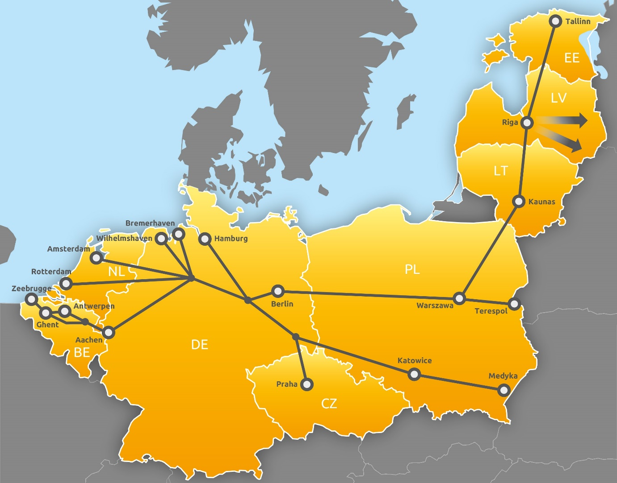
TCR Impact Sheets RFC 8 for timetable 2026 and 2027
Date: January 2025
Version 1.01

Slide 2
Impact sheets for selected major Temporary Capacity Restrictions (TCR)
Foreword
On RFC North Sea – Baltic we introduced the TCR Impact sheets to present in one glance general and important information about upcoming TCRs. These impact sheets highlight some infrastructure works which have a big impact on international rail freight traffic along RFC North Sea – Baltic.
Disclaimer:
The content of this document has been compiled with meticulous care based on information available at the publication date. However we cannot assume any liability for accuracy and accept no liability for damages suffered as a result of defects of this document.
For detailed and complete customer information we kindly refer to the information which is available via the involved national Infrastructure Managers.
Further information (e.g. in form of an excel list on all planned TCR) is available on the website of RFC NS-B under link: http://rfc8.eu/customer/temporary-capacity-restrictions/
Version 1.01 for timetable 2026 and 2027
Publication Date: January 2025

Slide 3
Impact of TCR TT 2026 at PKP PLK
Section Korsze Towarowa – Ełk Towarowy
Map view
Major Capacity Restriction
Location: Korsze Towarowa – Ełk Towarowy Type: Total Line Closure, see calendar Renewal Works: Track & Rail, Catenary, Telecommunications, Signalling Duration: Continuous
Impact on International Rail Freight
percentage of rerouting or cancellation: 100% rerouting due to total line closure extra running time for freight trains: yes deviation: via Olsztyn – Szczytno - Ełk timetable: TT 2023 - 2026 no restrictions in train parameters

Slide 4
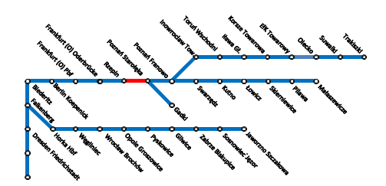
Impact of TCR TT 2026 at PKP PLK
Rzepin– Poznań Starołęka
20.01.2025
Map view
High Capacity Restriction
Location: Rzepin - Poznań Starołęka Type: one track operations, see calendar Renewal Works: Track works Duration: Continuous
Impact on International Rail Freight
percentage of rerouting or cancellation: 0% rerouting; one truck operation timetable: TT 2025 - 2026 no restrictions in train parameters

Slide 5
Impact of TCR TT 2026 at SZCZ
Section Decin - Lysa nad Labem
Map view
Major Capacity Restriction
Location Litoměřice dolní n. - Polepy Type: Single Track Operation Period: 13.07. - 01.08.2026 Type of works: repairs and maintenance
Impact on International Rail Freight
Cancellations: No Deviations: No Estimated extra running time: delay of freight trains approx. 30 - 60 minutes In annual timetable: Yes

Slide 6
Impact of TCR TT 2026 at DB InfraGO
Section Emmerich Border - Oberhausen Main Station
Updated January 2025
Map view
Major Capacity Restriction
Location: Emmerich Border - Oberhausen Main Station Type: Total Closure, Single Track Operation Period: Jan – May 2026 Type of works: Track & Rail, Bridge, Catenary, Switch, Miscellaneous
Impact on International Rail Freight
Cancellations: Yes Deviations: Yes Estimated extra running time: Detailed information on extra running time is distributed by DB Netz individually for every customer for each affected train. Additionally DB Netz offers train path advice free of charge In annual timetable: Yes

Slide 7
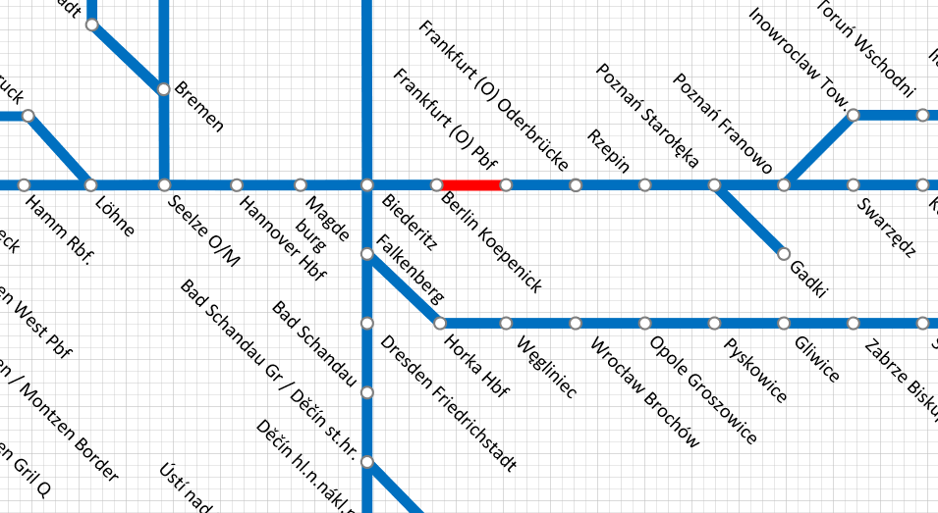
Impact of TCR TT 2026 at DB InfraGO
Frankfurt Oder - Erkner
Updated January 2025
Map view
Major Capacity Restriction
Location: Frankfurt Oder – Erkner (VZG 6153) Type: Total closure, Single track operation, Deviation from timetable for train reporting points, Travelling on opposite track Period: Dec 25 – Dec 26 Type of works: Track renewal, New train station Köpenick Complex TCR with various track restrictions on various sections between Frankfurt Oder and Erkner throughout the year.
Impact on International Rail Freight
Cancellations: No Deviations: Yes Estimated extra running time: Detailed information on extra running time is distributed by DB Netz individually for every customer for each affected train. Additionally DB Netz offers train path advice free of charge In annual timetable: Yes

Slide 8
Impact of TCR TT 2026 at DB InfraGO
Section Dresden – Děčín (Elbe valley)
Updated January 2025
Map view
Major Capacity Restriction
Location: Schöna – Bad Schandau (VZG 6240) Type: Single track operations and total closures Period: Jan 26 – Dec 26 Duration: Continuous/Periodical Works: Bridge, Noise protection, Catenary, Miscellaneous Most of the yellow marked times include total closures, which take place only during part of the day → Shiftwork!
Impact on International Rail Freight
Cancellations: Yes Deviations: Yes Estimated extra running time: Detailed information on extra running time is distributed by DB Netz individually for every customer for each affected train. Additionally DB Netz offers train path advice free of charge In annual timetable: Yes

Slide 9
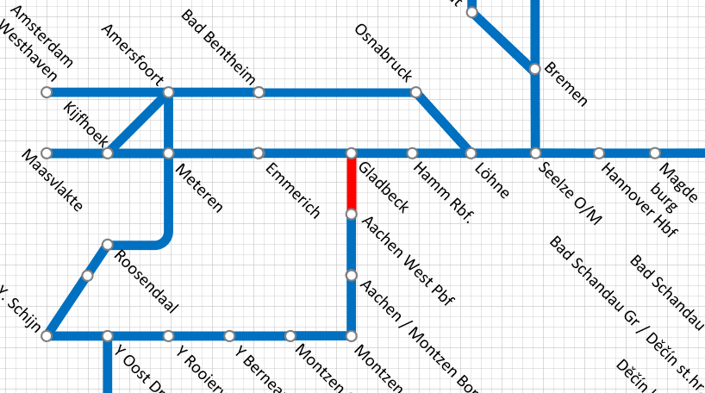
Impact of TCR TT 2026 at DB InfraGO
Aachen - Rheydt
Map view
Major Capacity Restriction
Location: Aachen - Rheydt Type: Total closure, Catenary, Travel on opposite track Period: January – October 26 Type of works: Bridge work, work on LST systems Total closures May – October periodical, not continuous
Impact on International Rail Freight
Cancellations: In coordination Deviations: Yes Estimated extra running time: Detailed information on extra running time is distributed by DB Netz individually for every customer for each affected train. Additionally DB Netz offers train path advice free of charge In annual timetable: Yes

Slide 10
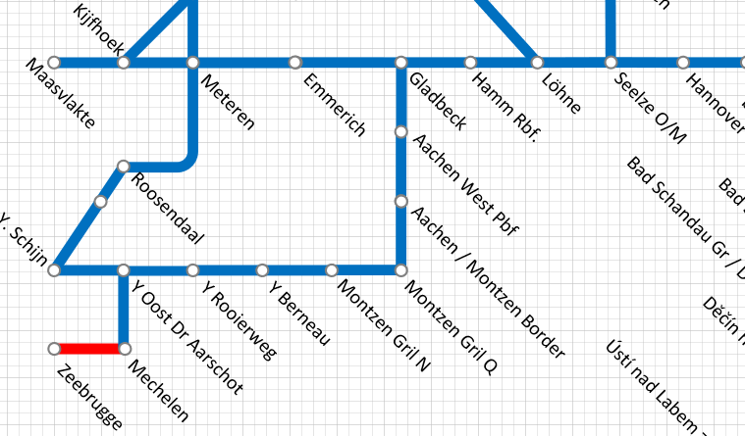
Impact of TCR TT 2026 at Infrabel
Section Zeebrugge - Montzen
Map view
Major Capacity Restriction
Location: Londerzele - Mechelen Total Closure Period: 27.06.2026 (4:00) – 06/07/2026 (04:00) Underground, track ans Bridge Renewal
Impact on International Rail Freight
Deviations: via L59 Estimated extra running time: tbd Restrictions for ad-hoc requests: no Restrictions in train parameters: no Restrictions in container profile: No In annual timetable: No

Slide 11
31.01.2025
Impact of TCR TT 2026 at ProRail
Section Kijfhoek – Meteren – Zevenaar (A15 Tracé)
Map view
Major Capacity Restriction
Location Kijfhoek – Meteren – Zevenaar (A15 trace) Type: Total Closure (combination 80-weeks) Periods: 27.04. -17.05.2026 Type of works: Renewal tunnel safety systems
Impact on International Rail Freight
Cancellations: No Deviations: Yes Estimated extra running time: delay of freight trains approx. 30 - 60 minutes In annual timetable: Yes (combination with the total closure weeks in the 80 weeks Emmerich-Oberhausen)

Slide 12
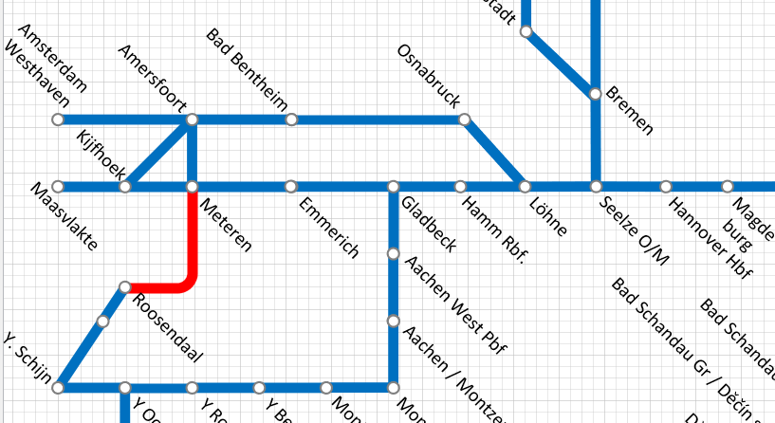
31.01.2025
Impact of TCR TT 2026 at ProRail
Section Breda - Tilburg
Map view
Major Capacity Restriction
Location Breda – Tilburg – Vught (aansluiting) Type: Total Closure Periods: 28.07. -08.08.2026 Type of works: Renewal of tracks and safety systems. New infrastructure on Tilburg Station
Impact on International Rail Freight
Cancellations: No Deviations: Yes, via Betuweroute (A15) - Emmerich Estimated extra running time: delay of freight trains approx. 30 - 90 minutes In annual timetable: No

Slide 13
Impact of TCR TT 2027 at SZCZ
Section Decin - Lysa nad Labem
Map view
Major Capacity Restriction
Location Hoštka - Polepy Type: Single Track Operation Period: 16.05. - 30.05.2027 Type of works: repairs and maintenance
Impact on International Rail Freight
Cancellations: No Deviations: No Estimated extra running time: delay of freight trains approx. 30 - 60 minutes In annual timetable: Yes

Slide 14
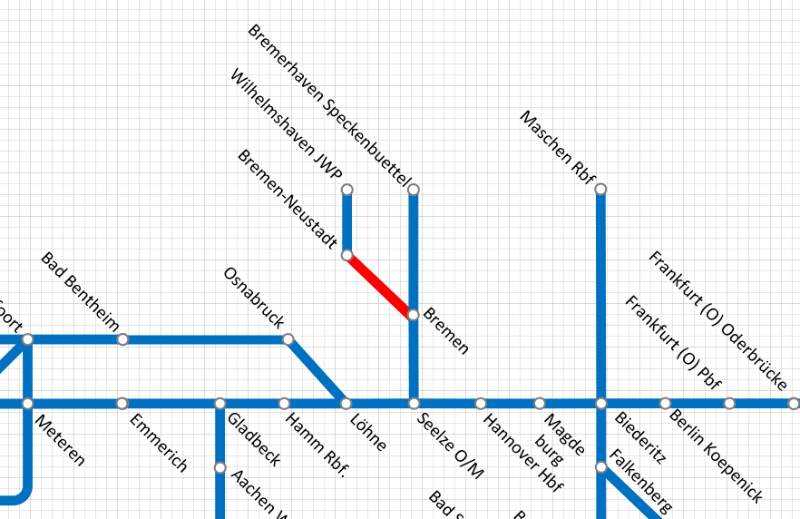
Impact of TCR TT 2027 at DB InfraGO
Bremen - Oldenburg
Map view
Major Capacity Restriction
Location: Bremen – Oldenburg (VZG 1500) Type: Single Closure Period: 15.10. – 10.12.2027 Type of works: Maintaining route availability and increasing capacity
Impact on International Rail Freight
Cancellations: Yes Deviations: Yes Estimated extra running time: Detailed information on extra running time is distributed by DB Netz individually for every customer for each affected train. Additionally DB Netz offers train path advice free of charge In annual timetable: tbd

Slide 15
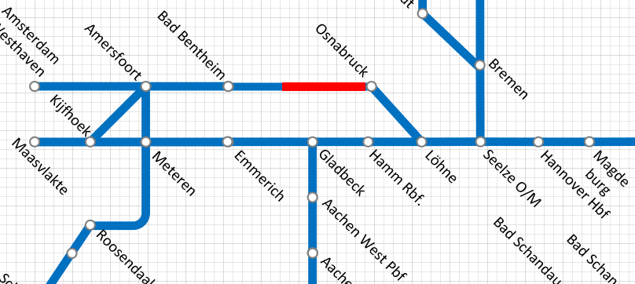
Impact of TCR TT 2027 at DB InfraGO
Osnabrück - Rheine
Map view
Major Capacity Restriction
Location: Osnabrück – Rheine (VZG 2992) Type: Total closure, Single Closure Period: July – December 2027 Total Closure: 09.07. – 15.10.2027 Single Track Operation: 15.10. – 10.12.2027 Type of works: Bridge work
Impact on International Rail Freight
Cancellations: No Deviations: Yes Estimated extra running time: Detailed information on extra running time is distributed by DB Netz individually for every customer for each affected train. Additionally DB Netz offers train path advice free of charge In annual timetable: tbd

Slide 16
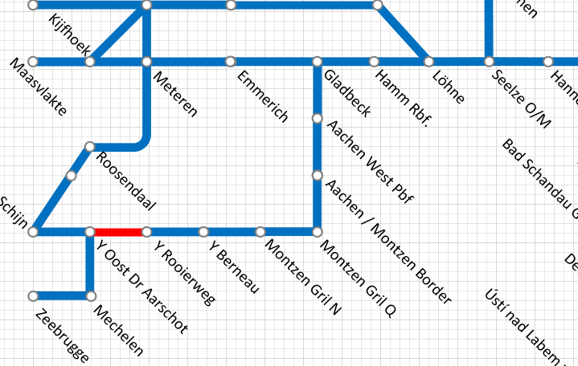
Impact of TCR TT 2027 at Infrabel
Section Y. Rooierweg – Y. Oost Dr Aarschot
Map view
Major Capacity Restriction
Location: Line 34 HASSELT-Y.ROOIERWEG Total Closure Period: 26/03/27 (23:40) to 19/04/27 (4:00) Type of works: Switches & tracks renewal
Impact on International Rail Freight
Deviations: via line 36 Estimated extra running time: 15 min Restrictions for ad-hoc requests: yes Restrictions in train parameters: no Restrictions in container profile: No In annual timetable: tbd in 2026

Slide 17
31.01.2025
Impact of TCR TT 2027 at ProRail
Section Breda - Tilburg
Map view
Major Capacity Restriction
Location Breda – Tilburg – Vught (aansluiting) Type: Total Closure Periods: 28.04. -13.05.2027 and 13.08 - 21.08. 2027 Type of works: Renewal of tracks and safety systems. New infrastructure on Tilburg Station
Impact on International Rail Freight
Cancellations: No Deviations: Yes, via Betuweroute (A15) - Emmerich Estimated extra running time: delay of freight trains approx. 30 - 90 minutes In annual timetable: No

Slide 18
31.01.2025
Impact of TCR TT 2027 at ProRail
Section Kijfhoek – Meteren – Zevenaar (A15 Tracé)
Map view
Major Capacity Restriction
Location Kijfhoek – Meteren – Zevenaar (A15 trace) Type: Total Closure (combination 80-weeks) Periods: 16.03. -29.03.2027 and 07.06 - 27.06.2027 Type of works: New Infrastructure as a result of works on Highway A15
Impact on International Rail Freight
Cancellations: No Deviations: Yes Estimated extra running time: delay of freight trains approx. 30 - 60 minutes In annual timetable: No

